Slide 1

Topic for the class: Introduction to AC circuits. Unit: II Title : AC Circuits Date: 04-04-2022 Time: 02:00PM
Mr. Pradeep Vinaik Kodavanti
Assistant Professor
Department of EECE
GITAM Institute of Technology (GIT)
Visakhapatnam – 530045
Email: pkodavan@gitam.edu

Slide 2

Course Objectives
To impart the analysis & design aspects of DC networks in electrical & electronic circuits.
To explain the basic concepts of AC networks used in electrical & electronic circuits.
To demonstrate the importance and operating principles of electrical machines. (transformers, motors and generators)
To impart the knowledge about the characteristics, working principles & applications of semiconductor diodes, MOSFETs.
To expose basic concepts & applications of OpAmp configurations.

Slide 3
Learning Outcomes
After completion of this unit, the student will be able to
Describe AC voltages and currents (L1).
Analyze Series RL, RC and RLC circuits (L4).
Learn calculations of power factor and power measurement (L2)
Understand star and delta connections in three phase systems (L3).

Slide 4
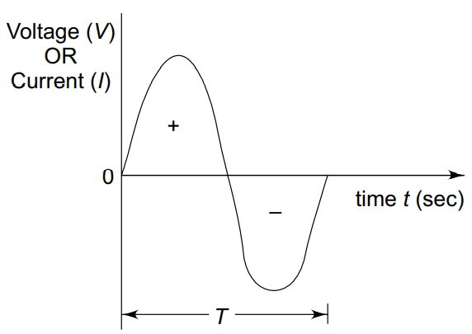
Sine Wave
Alternating voltages and currents are represented by a sinusoidal wave.
An alternating voltage (current) waveform is defined as the voltage (current) that fluctuates with time periodically, with change in polarity and direction.

Slide 5
Why sine wave ?
Any periodic waveform can be written in terms of sinusoidal function according to Fourier theorem.
If we take any second order system, the response of this system is a sinusoid.
Its derivatives and integrals are also sinusoids.
A sinusoidal function is easy to analyse.
Sinusoidal function is easy to generate.

Slide 6
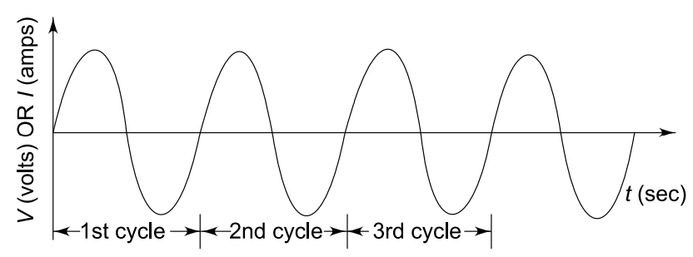
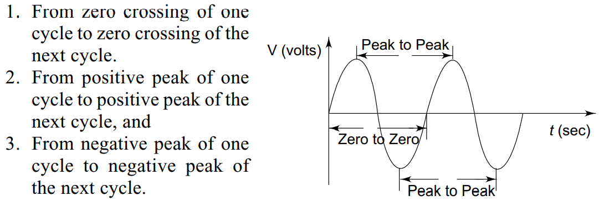

Sine wave
The time taken for any wave to complete one full cycle is called the period (T). $f(t) = f(t + T)$for any $t.$
Time period can be measured
in the following ways:

Slide 7
Sine wave contd…
The frequency of a wave is defined as the number of cycles that a wave completes in one second.
One Hertz is equivalent to one cycle per second.
A sine wave can be measured along the X-axis on a time base which is frequency-dependent.
A sine wave can also be expressed in terms of an angular measurement. This angular measurement is expressed in degrees or radians.
A radian is defined as the angular distance measured along the circumference of a circle which is equal to the radius of the circle. One radian is equal to 57.3°

Slide 8
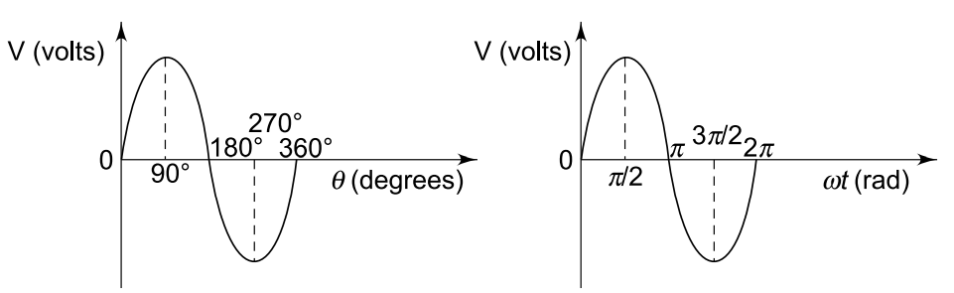
Angular relation of Sine wave
The angular measurement of a sine wave is based on 360° or 2π radians for a complete cycle.
A sine wave completes a half cycle in 180° or π radians; a quarter cycle in 90° or π /2 radians, and so on.

Slide 9
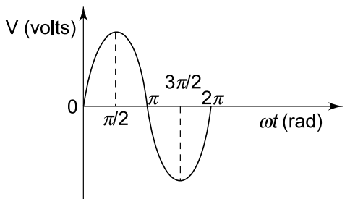
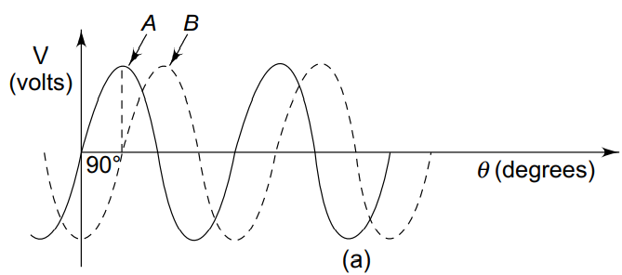
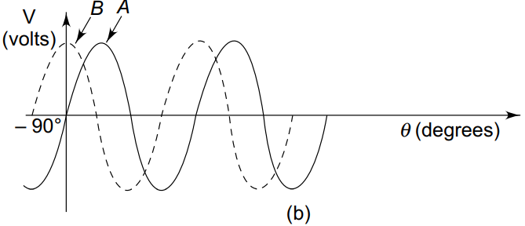


Phase of Sine wave
Phase of a sine wave is an angular measurement that specifies the position of sine wave relative to a reference.
Sine wave is shifted to the right and left by 90° (π/2 rad) shown by the dotted lines.
In both cases, the phase difference is 90°.
$B$ is lagging behind $A$
Or $A$ leads $B$ by ${90}^{o}$
$A$ is lagging behind $B$
Or $B$ leads $A$ by ${90}^{o}$

Slide 10
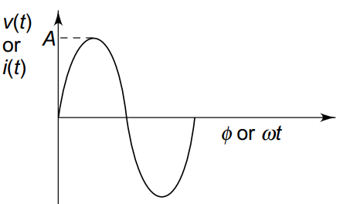
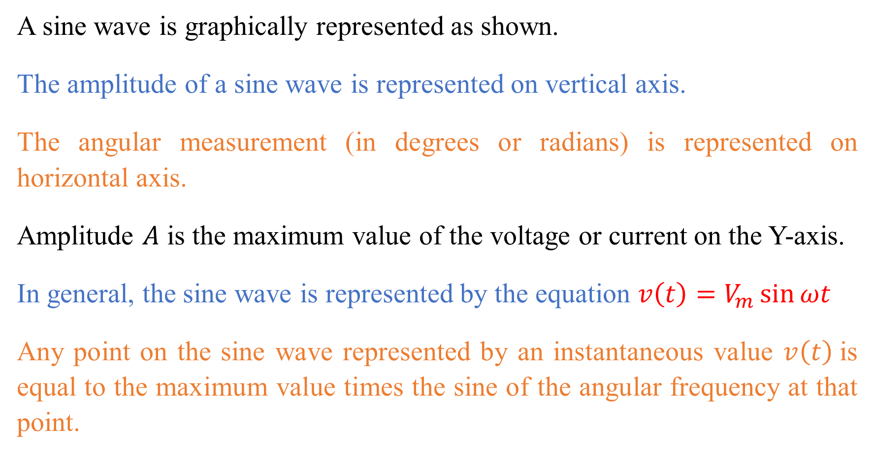
Sine wave Equation
A sine wave is graphically represented as shown.
The amplitude of a sine wave is represented on vertical axis.
The angular measurement (in degrees or radians) is represented on horizontal axis.
Amplitude $A$ is the maximum value of the voltage or current on the Y-axis.
In general, the sine wave is represented by the equation $v\left(t\right)=V_{m}\sin{ωt}$
Any point on the sine wave represented by an instantaneous value $v\left(t\right)$is equal to the maximum value times the sine of the angular frequency at that point.

Slide 11


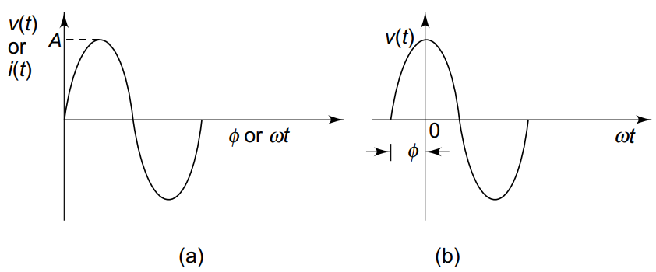
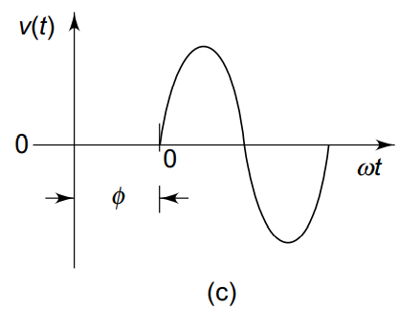

Sine wave Equation
When a sine wave is shifted to the left of the reference wave by a certain angle $∅$.
When a sine wave is shifted to the right of the reference wave by a certain angle $∅$.

Slide 12
Voltage & Current values of Sine wave
As the magnitude of the waveform is not constant, the waveform can be measured in different ways.
Instantaneous value,
Peak value,
peak to peak value,
root mean square (rms) value and
average value.

Slide 13
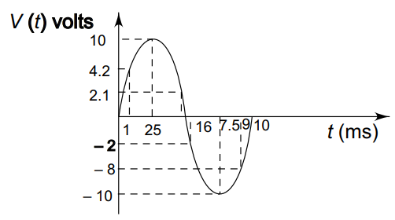
Instantaneous value of Sine wave
At any given time, it has some instantaneous value.
This value is different at different points along the waveform.
During the positive cycle, the instantaneous values are positive and during the negative cycle, the instantaneous values are negative.

Slide 14
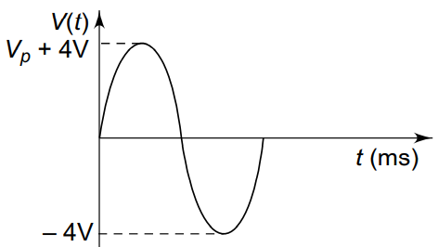
Peak value of Sine wave
The peak value of the sine wave is the maximum value of the wave during positive half cycle, or maximum value of wave during negative half cycle.
Since the value of these two are equal in magnitude, a sine wave is characterized by a single peak value.

Slide 15
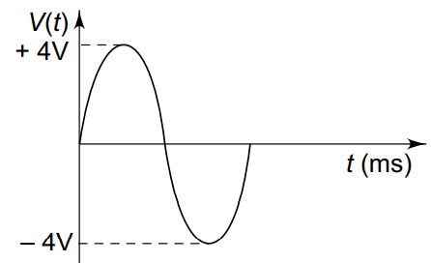
Peak to Peak value of Sine wave
The peak to peak value of a sine wave is the value from the positive to the negative peak.

Slide 16
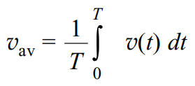
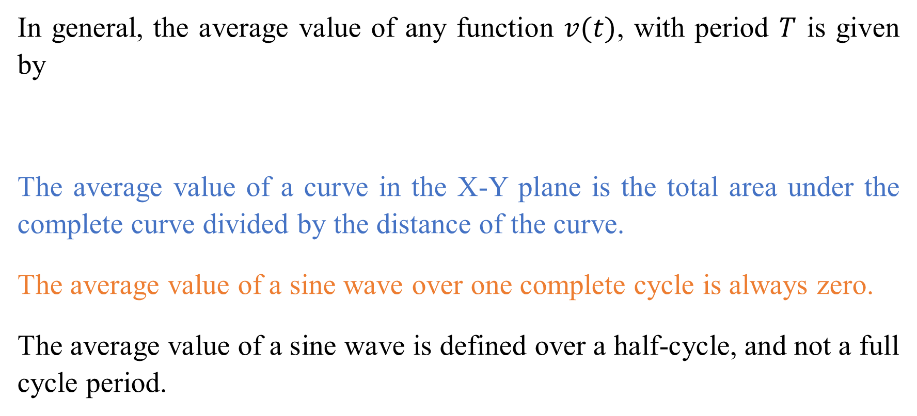
Average value of Sine wave
In general, the average value of any function $v(t)$, with period $T$ is given by
The average value of a curve in the X-Y plane is the total area under the complete curve divided by the distance of the curve.
The average value of a sine wave over one complete cycle is always zero.
The average value of a sine wave is defined over a half-cycle, and not a full cycle period.

Slide 17
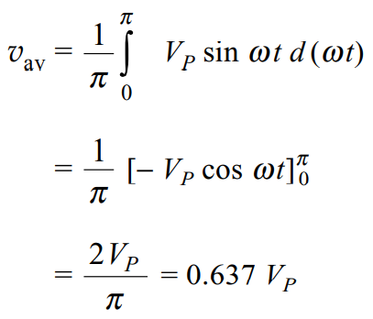
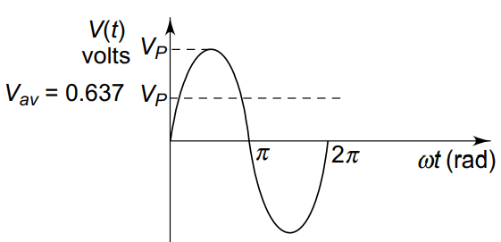
Average value of Sine wave contd…
Average value of a sine wave is given by

Slide 18
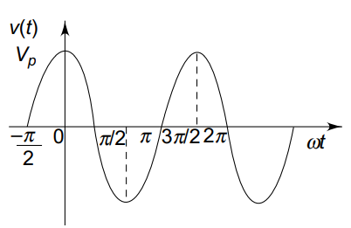
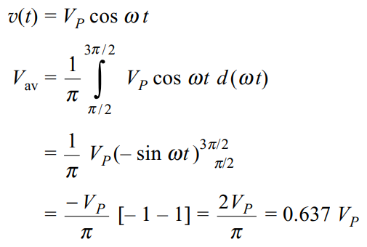

Average value of Cosine wave
Problem: Find the average value of a cosine wave $f(t) = cos⁡ωt$
Solution:

Slide 19
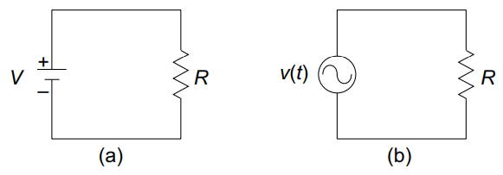
Root Mean Square Value or Effective Value
The root mean square (rms) value of a sine wave is a measure of the heating effect of the wave.
When a resistor is connected across a dc voltage source, a certain amount of heat is produced in the resistor in a given time.
A similar resistor is connected across an ac voltage source for the same time.
The value of the ac voltage is adjusted such
that the same amount of heat is produced in
the resistor as in the case of the dc source.
This value is called the rms value.

Slide 20
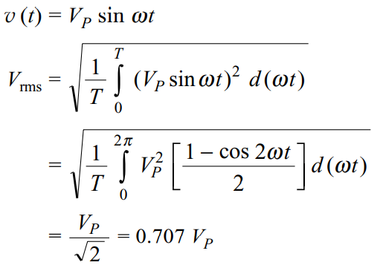

Root Mean Square Value or Effective Value contd…
The rms value of a sine wave is equal to the dc voltage that produces the same heating effect.
The rms value of any function with period $T$ has an effective value given by

Slide 21
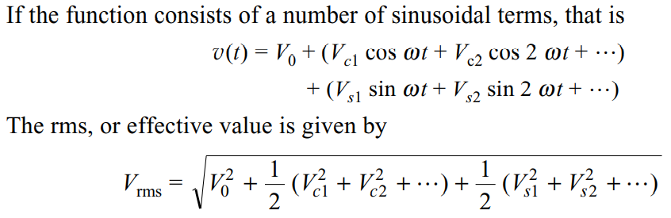
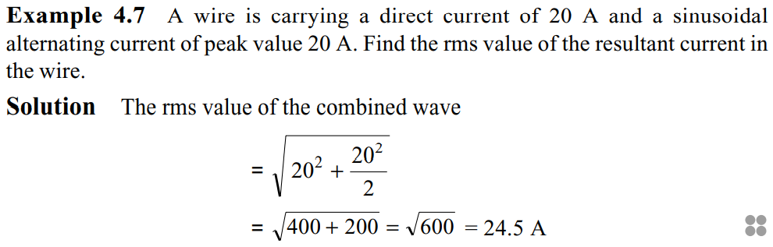
Root Mean Square Value or Effective Value contd…
Problem:
Solution:

Slide 22
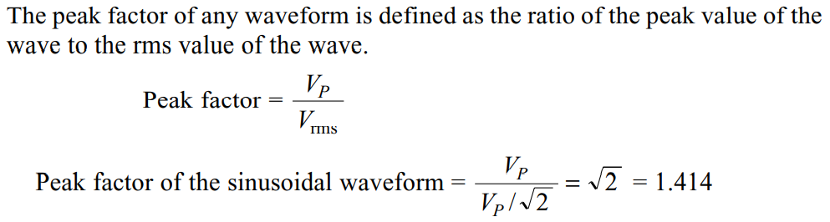
Peak Factor

Slide 23
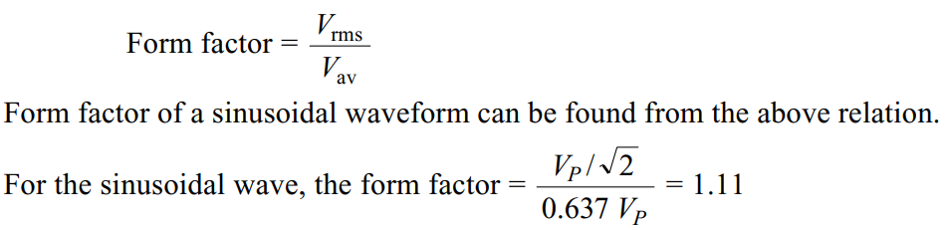
Form Factor

Slide 24
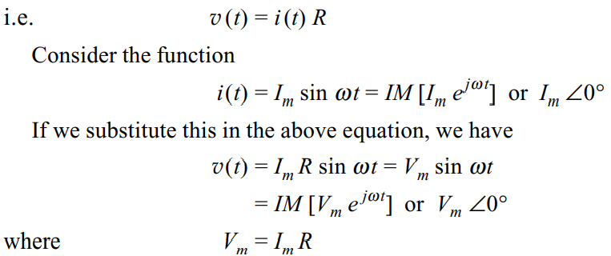
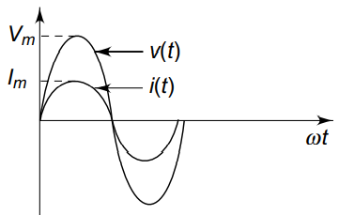
Phase relation in a resistor
When a sinusoidal voltage of certain magnitude is applied to a resistor, a certain amount of sine wave current passes through it.
No phase difference between these two waveforms. The amplitudes of the waveform may differ according to the value of resistance.

Slide 25

Phase relation in a resistor contd…
In pure resistive circuits, the voltages and currents are said to be in phase.
Impedance is defined as the ratio of voltage to current function.
With ac voltage applied to elements, the ratio of exponential voltage to the corresponding current (impedance) consists of magnitude and phase angles.
Since the phase difference is zero in case of a resistor, the phase angle is zero.

Slide 26
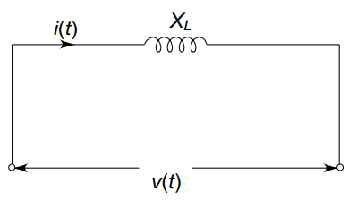
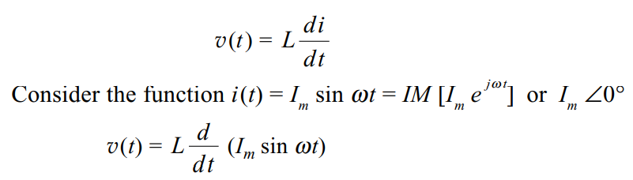
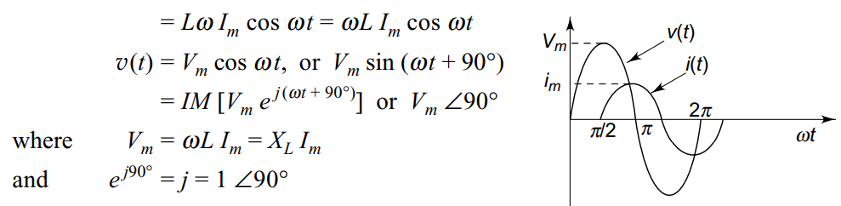
Phase relation in an Inductor

Slide 27
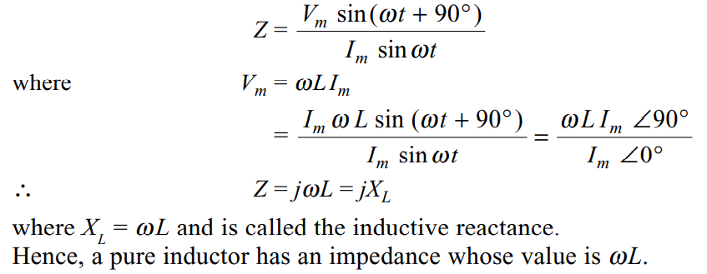
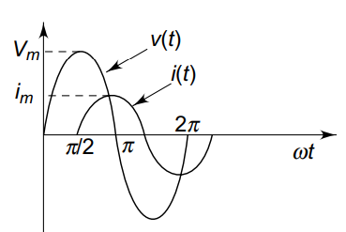
Phase relation in an Inductor contd…

Slide 28
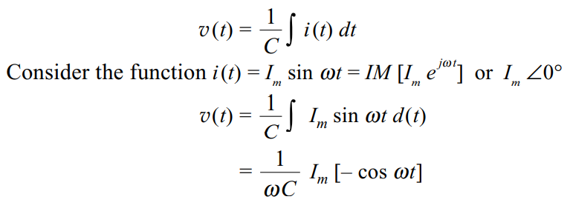
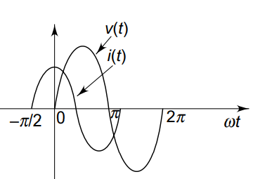
Phase relation in a Capacitor

Slide 29
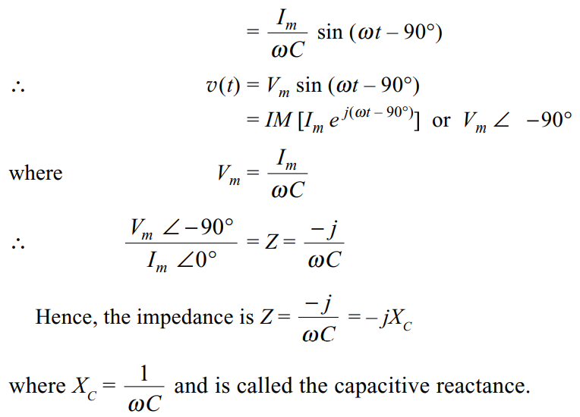
Phase relation in a Capacitor contd…

Slide 30
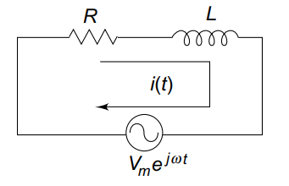


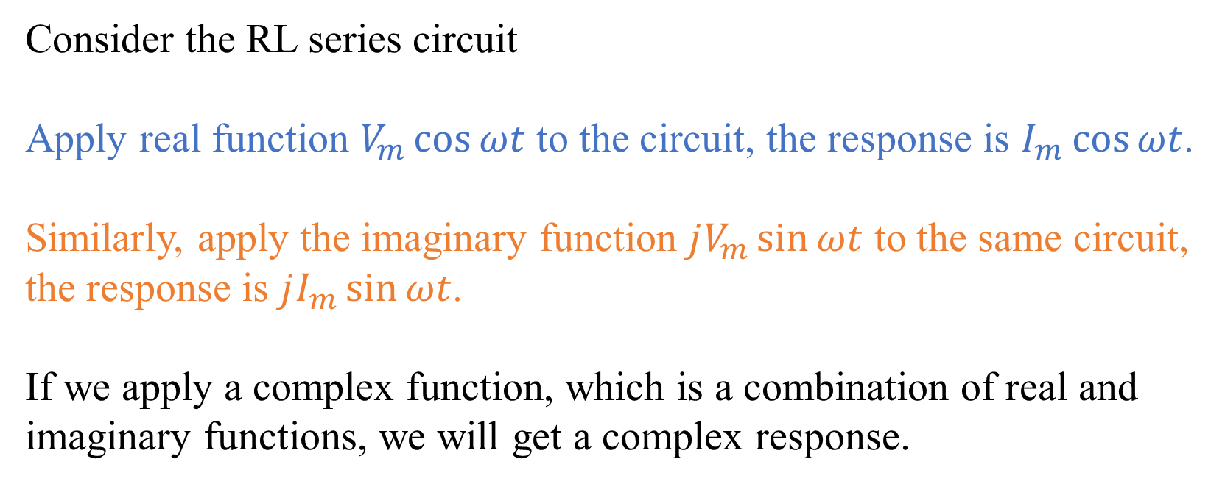
Series RL Circuit
Consider the RL series circuit
Apply real function $V_{m}\cos{ωt}$ to the circuit, the response is $I_{m}\cos{ωt}$.
Similarly, apply the imaginary function $jV_{m}\sin{ωt}$ to the same circuit, the response is $jI_{m}\sin{ωt}$.
If we apply a complex function, which is a combination of real and imaginary functions, we will get a complex response.

Slide 31
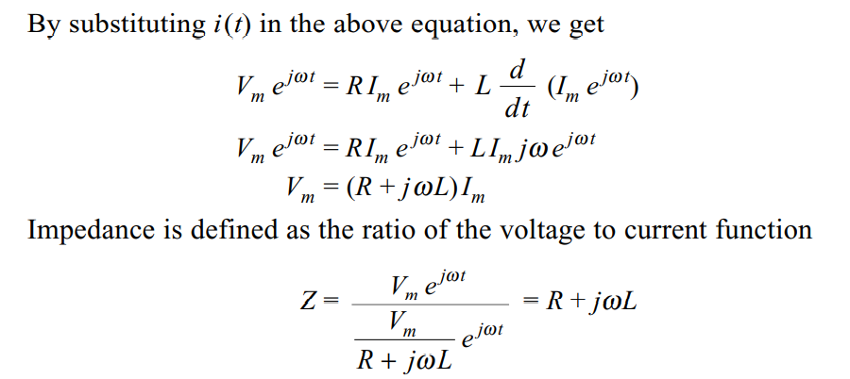
Series RL Circuit contd…

Slide 32
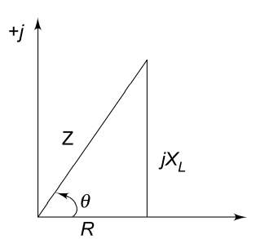
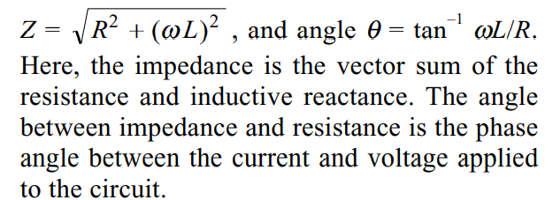
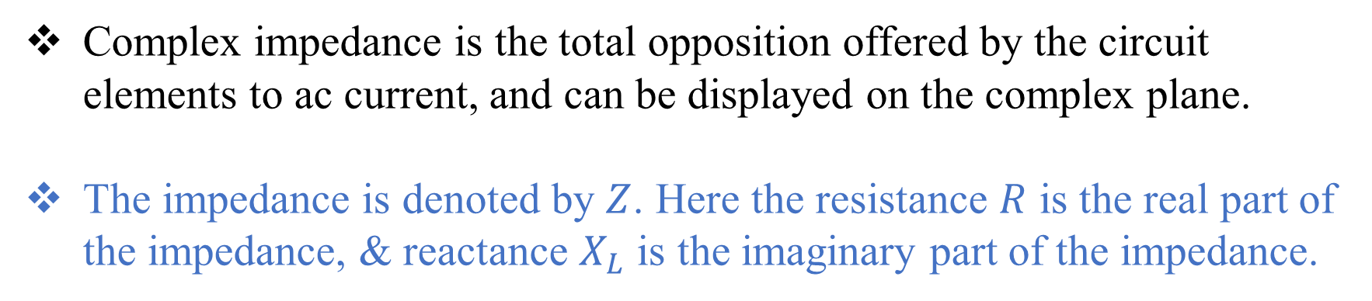
Series RL Circuit contd…
Complex impedance is the total opposition offered by the circuit elements to ac current, and can be displayed on the complex plane.
The impedance is denoted by $Z$. Here the resistance $R$ is the real part of the impedance, & reactance $X_{L}$ is the imaginary part of the impedance.
Impedance diagram

Slide 33
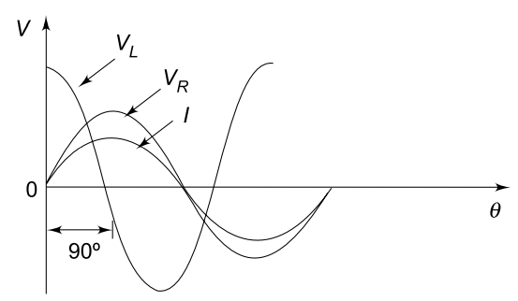
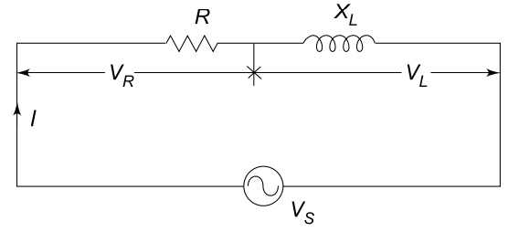
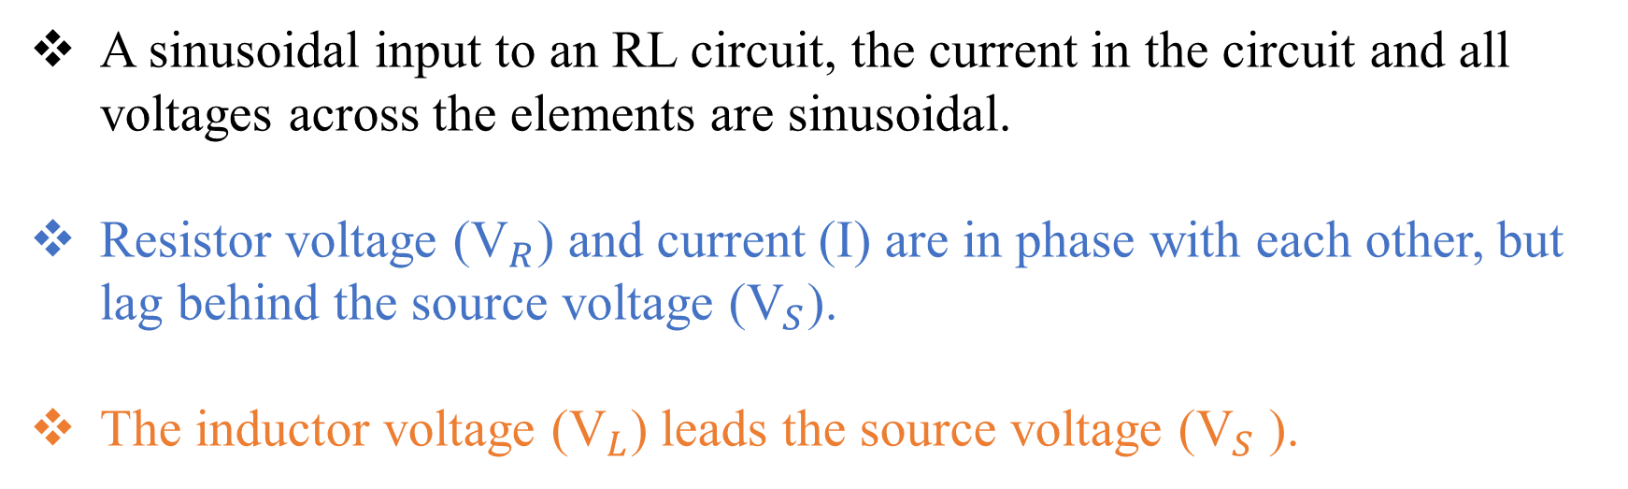
Series RL Circuit contd…
A sinusoidal input to an RL circuit, the current in the circuit and all voltages across the elements are sinusoidal.
Resistor voltage (${\text{V}}_{R}$) and current (I) are in phase with each other, but lag behind the source voltage (${\text{V}}_{S}$).
The inductor voltage (${\text{V}}_{L}$) leads the source voltage (${\text{V}}_{S}$ ).

Slide 34
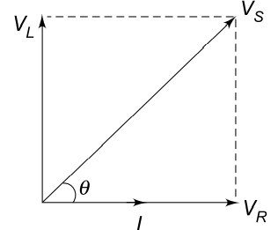

Series RL Circuit contd…

Slide 35



Series RL Circuit contd…
Problem: In the circuit shown, a 10 V rms, 10 kHz signal is applied. Find impedance Z, current I, phase angle q, voltage across resistance and the voltage across inductance.
Solution

Slide 36

Series RL Circuit contd…

Slide 37


Series RC Circuit
Applying Kirchhoff’s law

Slide 38




Series RC Circuit contd…

Slide 39





Series RC Circuit contd…

Slide 40


Series RC Circuit contd…
Problem: A sine wave generator supplies a 500 Hz, 10 V rms signal to a 2 kΩ resistor in series with a 0.1 µF capacitor. Determine the total impedance Z, current I, phase angle, capacitive voltage and resistive voltage?
Solution:

Slide 41

Series RC Circuit contd…

Slide 42




Series RLC Circuit
A series RLC circuit is the series combination of resistance, inductance and capacitance.
In the impedance diagrams of series RL and series RC circuits, the inductive reactance, is displayed on the + j axis and the capacitive reactance is displayed on the – j axis. These reactance are 180° apart and tend to cancel each other.
$Z=\sqrt{R^{2}+{\left(X_{L}−X_{C}\right)}^{2}}$ and $θ=\tan^{−1}{\frac{\left(X_{L}−X_{C}\right)}{R}}$

Slide 43


Series RLC Circuit contd…
Problem: In the circuit shown, determine the total impedance, current I, phase angle q, and the voltage across each element.
Solution:

Slide 44


Series RLC Circuit contd…

Slide 45
Instantaneous Power
In a purely resistive circuit, all the energy delivered by the source is dissipated in the form of heat by the resistance.
In a purely reactive (inductive or capacitive) circuit, all the energy delivered by the source is stored by the inductor or capacitor in its magnetic or electric field during a portion of the voltage cycle, and then is returned to the source during another portion of the cycle, so that no net energy is transferred.

Slide 46

Instantaneous Power contd…
Instantaneous power consists of two parts. One is a fixed part, and the other is time-varying which has a frequency twice that of the voltage or current waveforms.

Slide 47


Instantaneous Power contd…
Instantaneous power is negative, whenever the voltage and current are of opposite sign.

Slide 48
Instantaneous Power contd…
Positive portion of the power is greater than the negative portion of the power.
Hence the average power is always positive, which is almost equal to the constant part of the instantaneous power.

Slide 49

Instantaneous Power contd…
The positive portion of the power cycle varies with the phase angle between the voltage and current waveforms.
If the circuit is pure resistive, the phase angle between voltage and current is zero; then there is no negative cycle in the $P(t)$ curve.
Hence, all the power delivered by the source is completely dissipated in the resistance.

Slide 50



Instantaneous Power contd…
Power wave has a frequency twice that of the voltage or current.
The average value of power is $V_{m}I_{m}/2$.

Slide 51

Instantaneous Power contd…
When phase angle $ϴ$ is increased, the negative portion of the power cycle increases and lesser power is dissipated.
When $ϴ$ becomes π/2, the positive and negative portions of the power cycle are equal.
At this instant, the power dissipated in the circuit is zero, i.e. the power delivered to the load is returned to the source.

Slide 52


Average Power

Slide 53



Average Power contd…
Average power = product of the effective values of both voltage and current multiplied by cosine of the phase angle between voltage and the current.
Purely resistive circuit

Slide 54


Average Power contd…
Problem: A voltage of $v(t) = 100 sin⁡wt$is applied to a circuit. The current through the circuit is $i(t) = 15 sin⁡(wt – 30°).$Determine average power delivered to the circuit.
Solution:

Slide 55

Average Power contd…
Problem:
Solution:

Slide 56

Power Factor
Power factor is useful in determining useful power (true power) transferred to a load.
The highest power factor is 1, which indicates that the current to a load is in phase with the voltage across it (i.e. in the case of resistive load).
When the power factor is 0,
the current to a load is 90°
out of phase with the voltage
(i.e. in case of reactive load).

Slide 57

Power Factor contd…
The average power is expressed in watts.
The useful power transferred from the source to the load, which is also called true power.
If a dc source applied to the network, true power is given by the product of the voltage and the current.
If sinusoidal voltage applied to the circuit, the product of voltage and current is called apparent power. The apparent power is expressed in volt amperes, or simply VA.

Slide 58


Power Factor contd…
Power factor is defined as the ratio of average power to the apparent power.
Apparent power is the product of the effective values of the current and the voltage.
Power factor is also defined as the factor with which the volt amperes are to be multiplied to get true power in the circuit.
In the case of sinusoidal sources, the power factor is the cosine of the phase angle between voltage and current.

Slide 59
Power Factor contd…
As the phase angle between voltage and total current increases, the power factor decreases.
The smaller the power factor, the smaller the power dissipation.
The power factor varies from 0 to 1.
For purely resistive circuits, the phase angle between voltage and current is zero, and hence the power factor is unity.
For purely reactive circuits, the phase angle between voltage and current is 90°, and hence the power factor is zero.

Slide 60
Power Factor contd…
In an RC circuit, the power factor is referred to as leading power factor because the current leads the voltage.
In an RL circuit, the power factor is referred to as lagging power factor because the current lags behind the voltage.

Slide 61

Power Factor contd…
Problem:
Solution:

Slide 62
Polyphase System
In an ac system it is possible to connect two or more number of individual circuits to a common polyphase source.
Though it is possible to have any number of sources in a polyphase system, the increase in the available power is not significant beyond the three-phase system.
The power generated by the same machine increases 41.4 per cent from single phase to two-phase, and the increase in the power is 50 per cent from single phase to three-phase.

Slide 63

Three phase System
A three-phase system of voltages (currents) is merely a combination of three single phase systems of voltages (currents) of which the three voltages (currents) differ in phase by 120 electrical degrees from each other in a particular sequence.

Slide 64

Three phase System
The three voltages are of the same magnitude and frequency, but are displaced from one another by 120°.
Assuming the voltages are sinusoidal, the equations for the instantaneous values of the voltages of the three phases. Counting the time from the instant when the voltage in phase R is zero. The equations are
At any given instant, the algebraic sum of the three voltages must be zero.

Slide 65


Wye or Star-Connection
Three-phase, four-wire, star-connected system.
The terminals R, Y and B are called the line terminals of the source.
The voltage between any line and the neutral point is called the phase voltage ($V_{RN}$, $V_{YN}$and $V_{BN}$), while the voltage between any two lines is called the line voltage ($V_{RY}$, $V_{YB}$and $V_{BR}$).
The currents flowing through the phases are called the phase currents, while those flowing in the lines are called the line currents.

Slide 66
Wye or Star-Connection contd …
If neutral wire is not available for external connection, the system is called a three-phase, three wire, star-connected system.
The system so formed will supply equal line voltages displaced 120° from one another and acting simultaneously in the circuit like three independent single phase sources.

Slide 67


Inter-connection of Loads

Slide 68


Delta or Mesh-connection
Three line conductors are taken from the three junctions of the mesh or delta connection to feed the three-phase load.
This constitutes a three-phase, three-wire, delta-connected system.
There is no common terminal.
Only three line voltages $V_{RY}$, $V_{YB}$
and $V_{BR}$ are available.
Line voltages are also referred to
as phase voltages.

Slide 69



Star to Delta & Delta to Star

Slide 70



Balanced Star to Delta & Delta to Star

Slide 71




Power in a Star connected network
The total active power or true power in the three-phase load is the sum of the powers in the three phases.
For a balanced load, the power in each load is the same; hence total power = 3 × power in each phase.
The three-phase power in terms of line quantities as follows.
Active power is and reactive power is

Slide 72

Power in a Star connected network contd…
Active power is given by
reactive power is given by
Total apparent power is given by

Slide 73


Power in a Delta connected network

Slide 74

Problem:

Slide 75

Measurement of Power
Power Measurement in a Single Phase Circuit by Wattmeter:
Wattmeter's are used to measure power in the circuits.
A wattmeter principally consists of two coils, one coil is called the current coil, and the other the pressure or voltage coil.
Coil with less number of turns
between M and L is the current
coil, which carries the current
in the load and has very low
impedance.

Slide 76
Measurement of Power contd…
Coil with more number of turns between the common terminal & V is the pressure coil, connected across the load and has high impedance.
The load voltage is impressed across the pressure coil.
Terminal M -> mains side
L -> load side
common -> common point of current coil & pressure coil
V -> second terminal of the pressure coil.

Slide 77
Measurement of Power contd…
Current flow through the two coils, set up magnetic fields in space.
An electromagnetic torque is produced by the interaction of the two magnetic fields.
Under the influence of the torque, one of the coils (which is movable) moves on a calibrated scale against the action of a spring.
The instantaneous torque produced by electromagnetic action is proportional to the product of the instantaneous values of the currents in the two coils

Slide 78

Measurement of Power contd…
The small current in the pressure coil is equal to the input voltage divided by the impedance of the pressure coil.
The inertia of the moving system does not permit it to follow the instantaneous fluctuations in torque.
The wattmeter deflection is therefore, proportional to the average power (VI cos$∅$)

Slide 79


Three Wattmeter Method
The current coils of three wattmeter's are introduced in three lines.
One terminal of each potential coil is connected to one terminal of the corresponding current coil, the other three being connected to some common point which forms an effective neutral.
The reading on the wattmeter WR will correspond to the average value.

Slide 80




Three Wattmeter Method contd…

Slide 81

Two Wattmeter Method
If neutral wire is available, it should not carry any current, or the neutral of the load should be isolated from the neutral of the source.
The current through the current coil of each wattmeter is the line current, and the voltage across the pressure coil is the line voltage.

Slide 82

Two Wattmeter Method

Slide 83

Two Wattmeter Method
Total Power,

